Slide 1
Open Local Knowledge Graph Construction from Academic Papers Using Generative Large Language Models (paper2lkg)
Haoting Chen
u7227871@anu.edu.au
School of Computing, Australian
National University
Canberra, ACT, Australia
Dr Sergio José Rodríguez Méndez
Sergio.RodriguezMendez@anu.edu.au
School of Computing, Australian
National University
Canberra, ACT, Australia
Dr Pouya Ghiasnezhad Omran
P.G.Omran@anu.edu.au
School of Computing, Australian
National University
Canberra, ACT, Australia

Slide 2
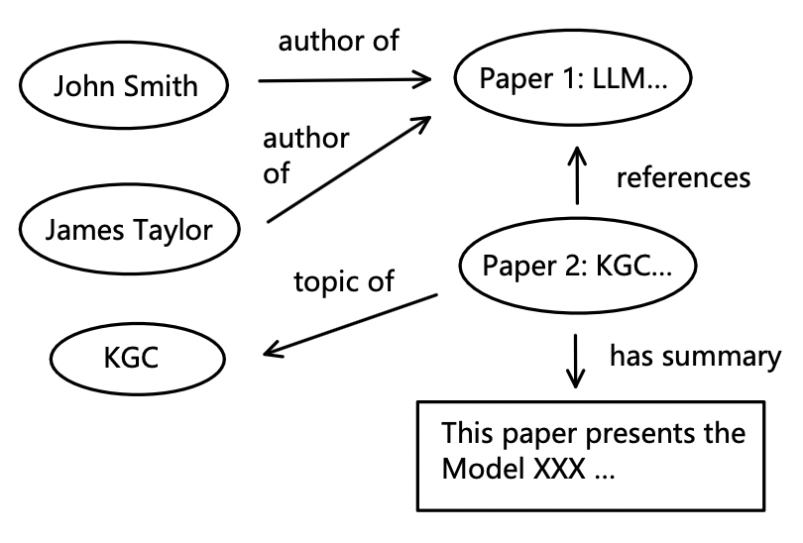
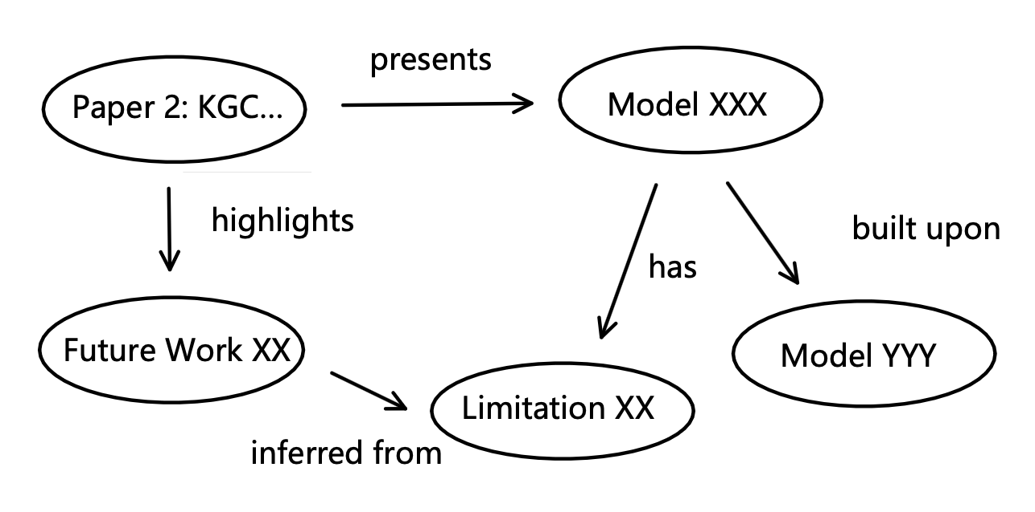
Motivation for Building Local Academic KG
1️⃣. What does an academic KG usually have?
Current academic KGs typically lack a detailed and structured representation of the local knowledge conveyed in each paper.
Many global/inter-paper knowledge
Some internal/local knowledge
3️⃣. What if they are combined?
2️⃣. What can a local academic KG provide?
Structured academic knowledge is preserved to a greater extent.
Enable more complex querying
All about local knowledge within a single paper

Slide 3
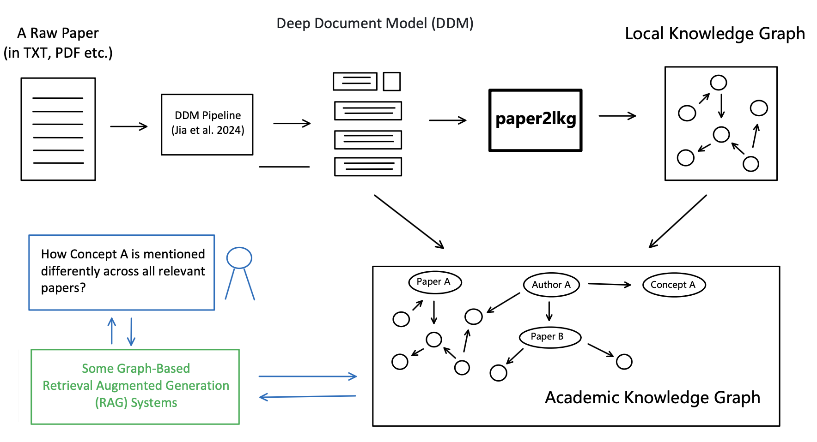
Potential Application

Slide 4
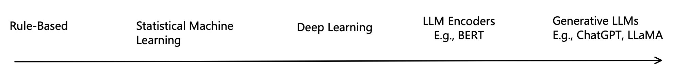
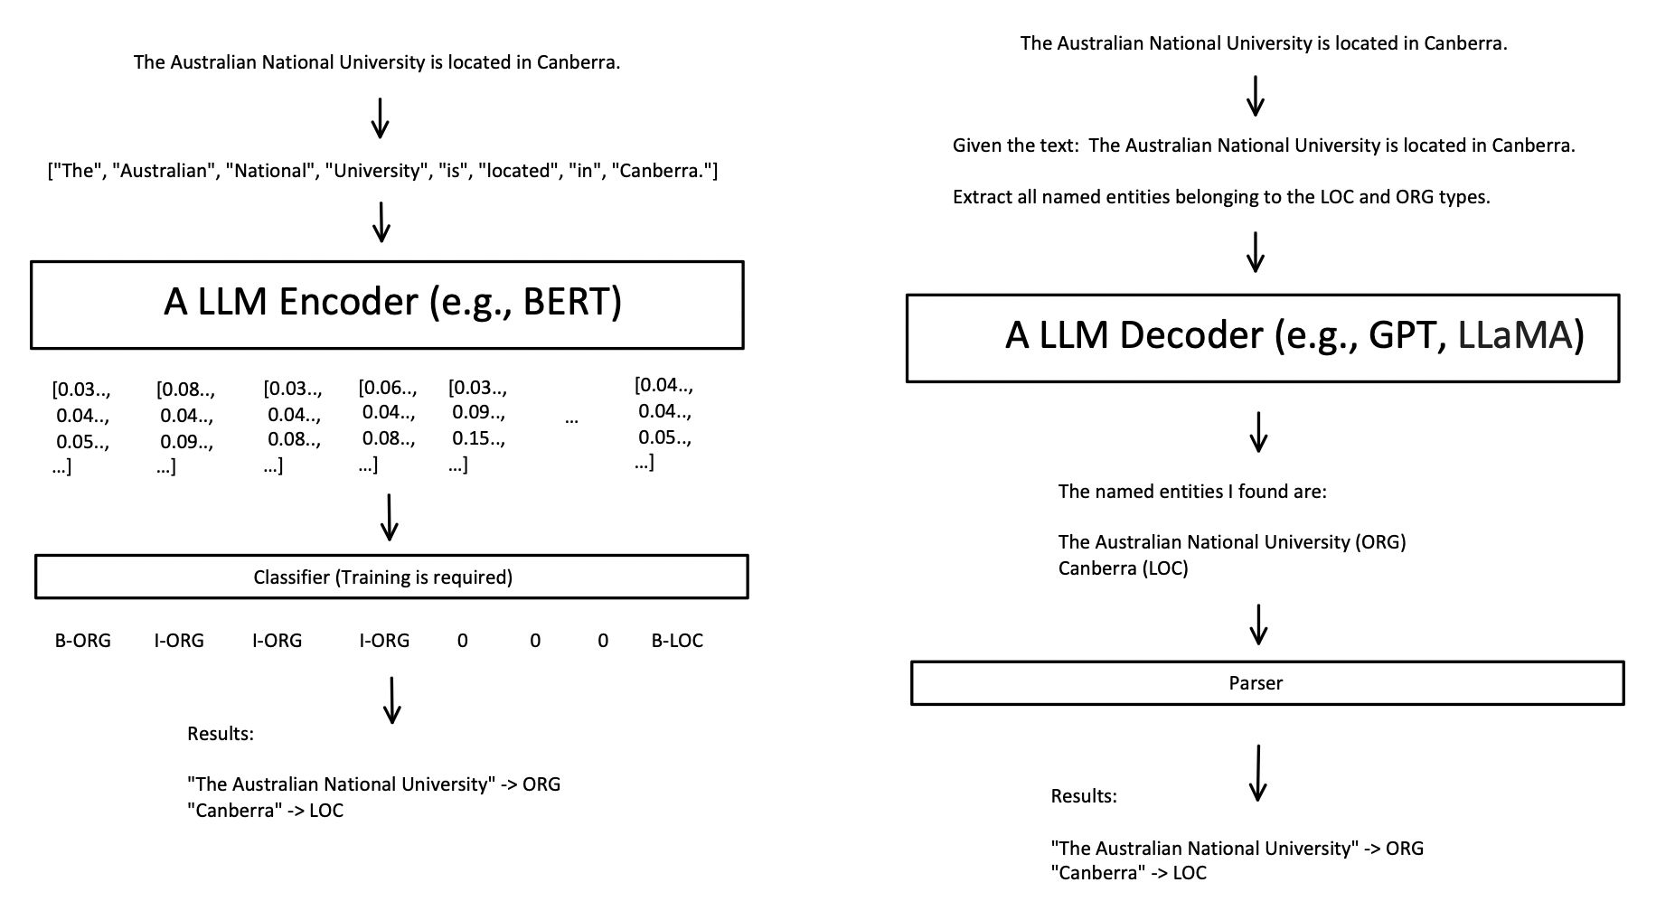
Motivation for Using Generative LLMs
Simple to use:
Minimal or no training or fine-tuning required
More adaptive:
No need to worry about the domain adaptation problem due to a limited fine-tuning dataset.
If the underlying LLM get replaced or upgraded, the local KG construction pipeline should still work.
But high complexity:
Still, worth studying the downside.
Single-Pass
Autoregressive

Slide 5
Goals
Present a pipeline design and its corresponding prototype that can transform individual papers into their local Knowledge Graph representation, by leveraging generative LLMs as much as possible.
Briefly discover the efficiency and efficacy of using such a local KGC pipeline that is mostly based on generative LLMs.

Slide 6
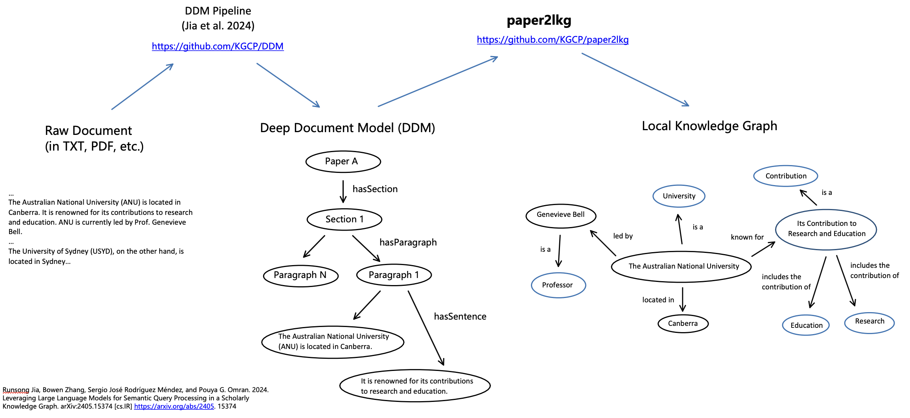
Input & Output

Slide 7
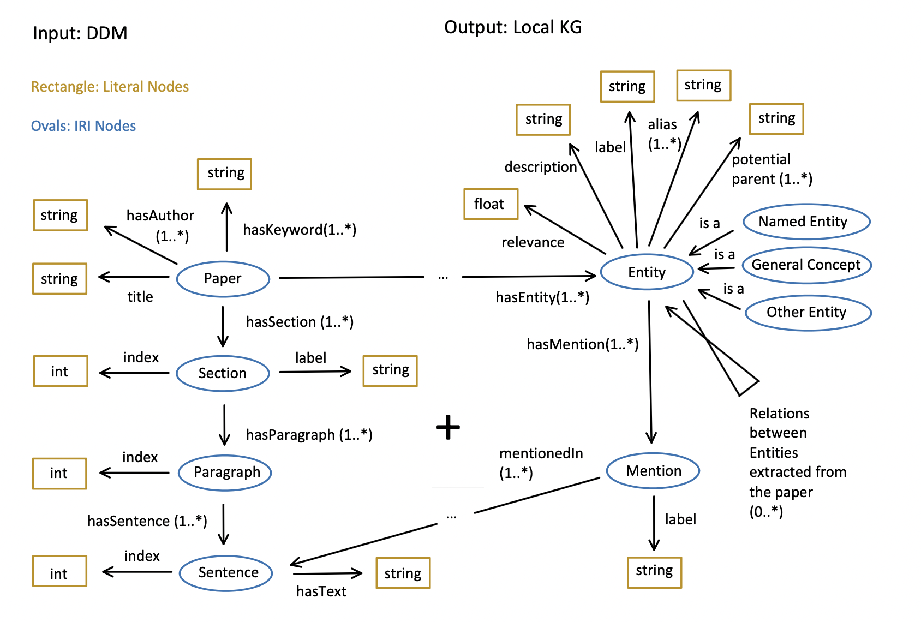
Input & Output (Ontology)

Slide 8
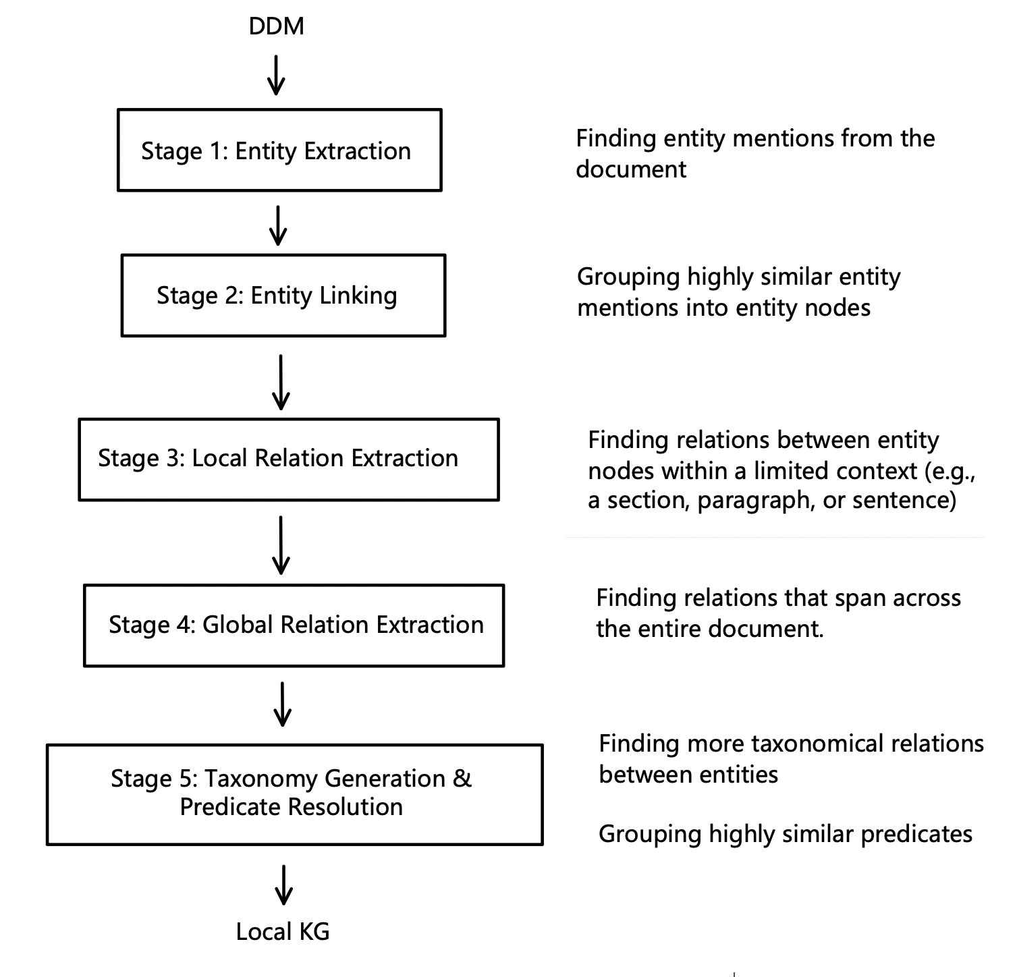
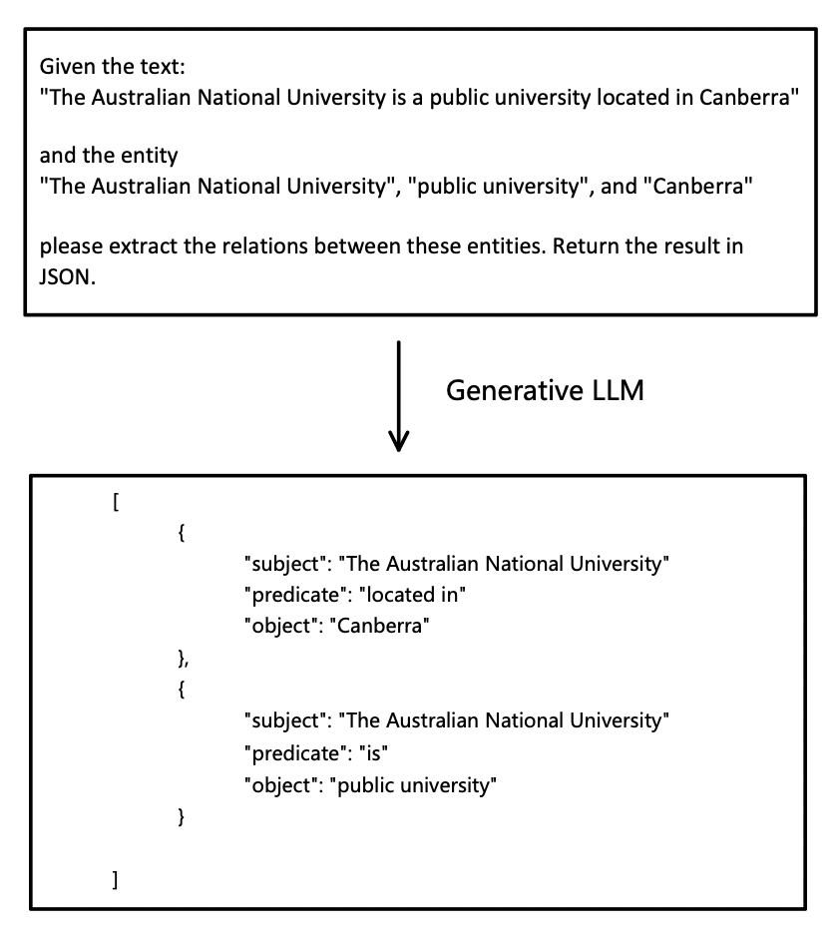
Implementation: Overview
A simple LLM prompt for Local Relation Extraction

Slide 9
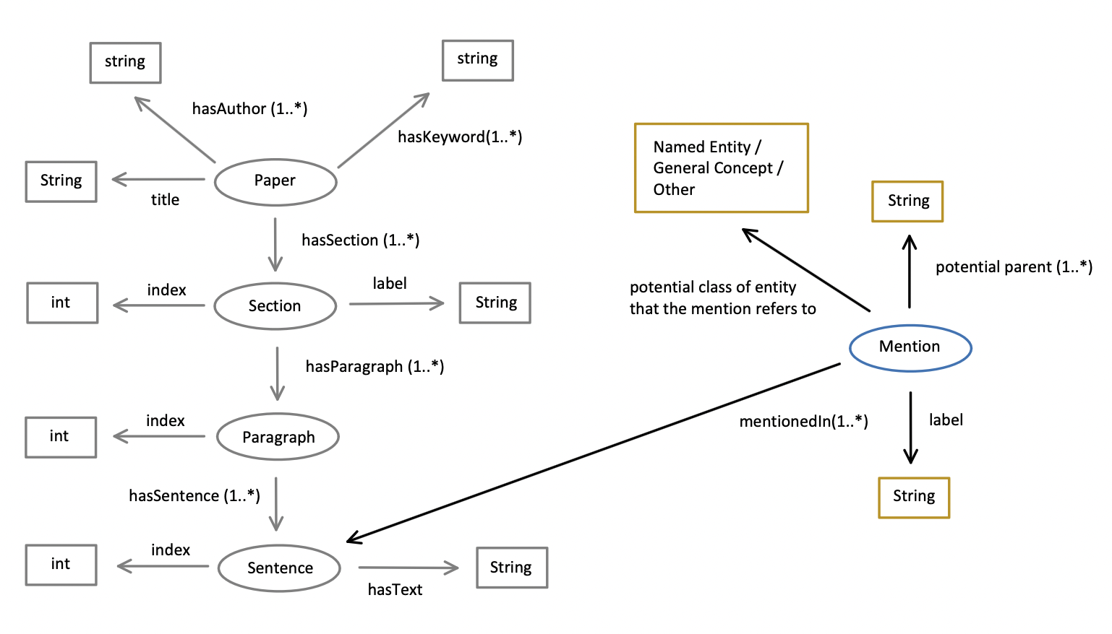
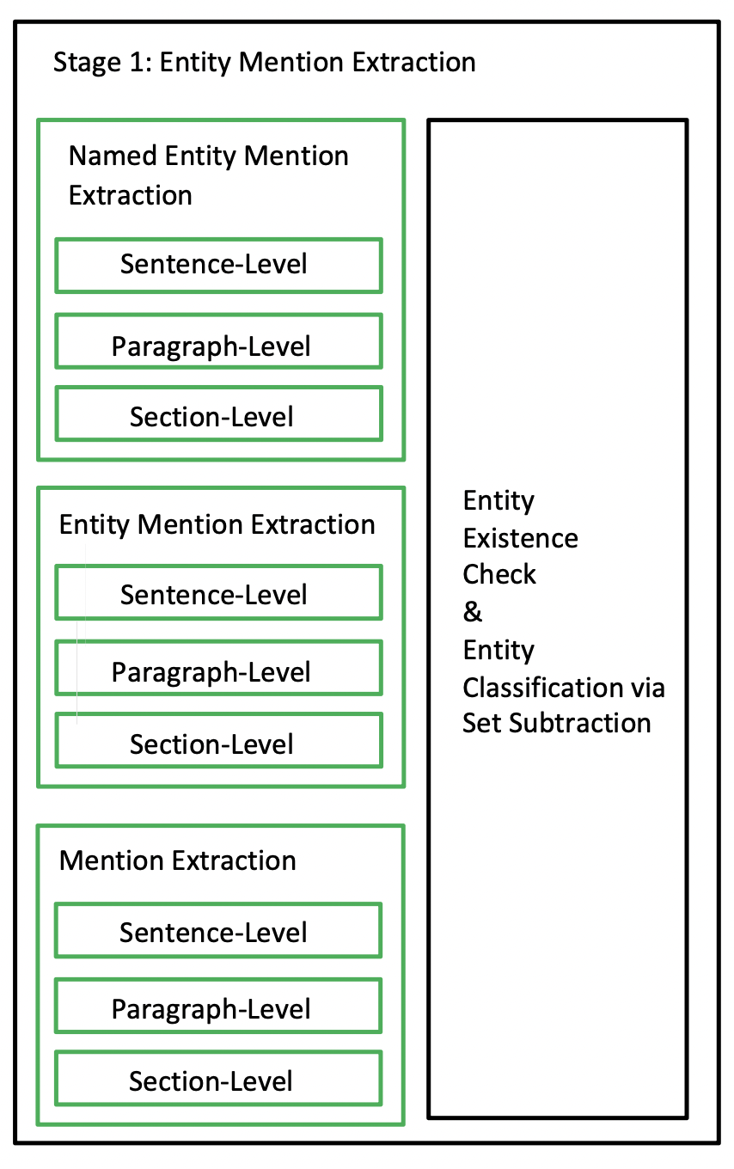
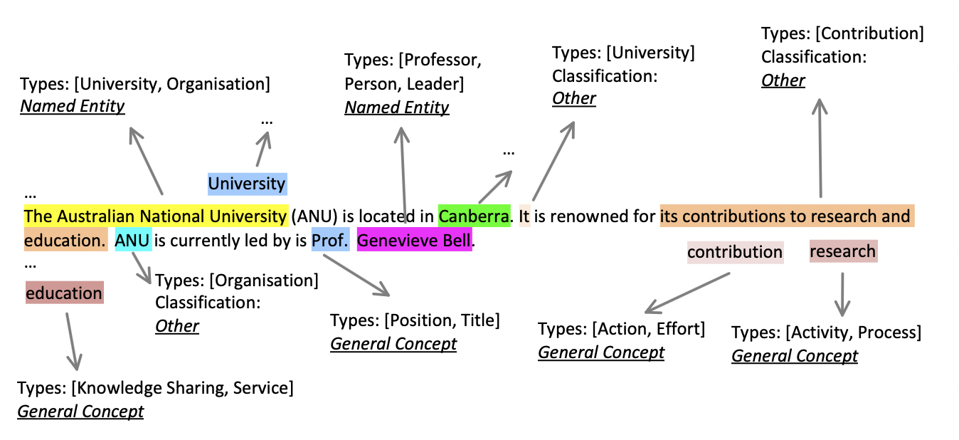
Stage 1: Entity Extraction
KG Structure After
Stage 1
Stage 1 Example

Slide 10
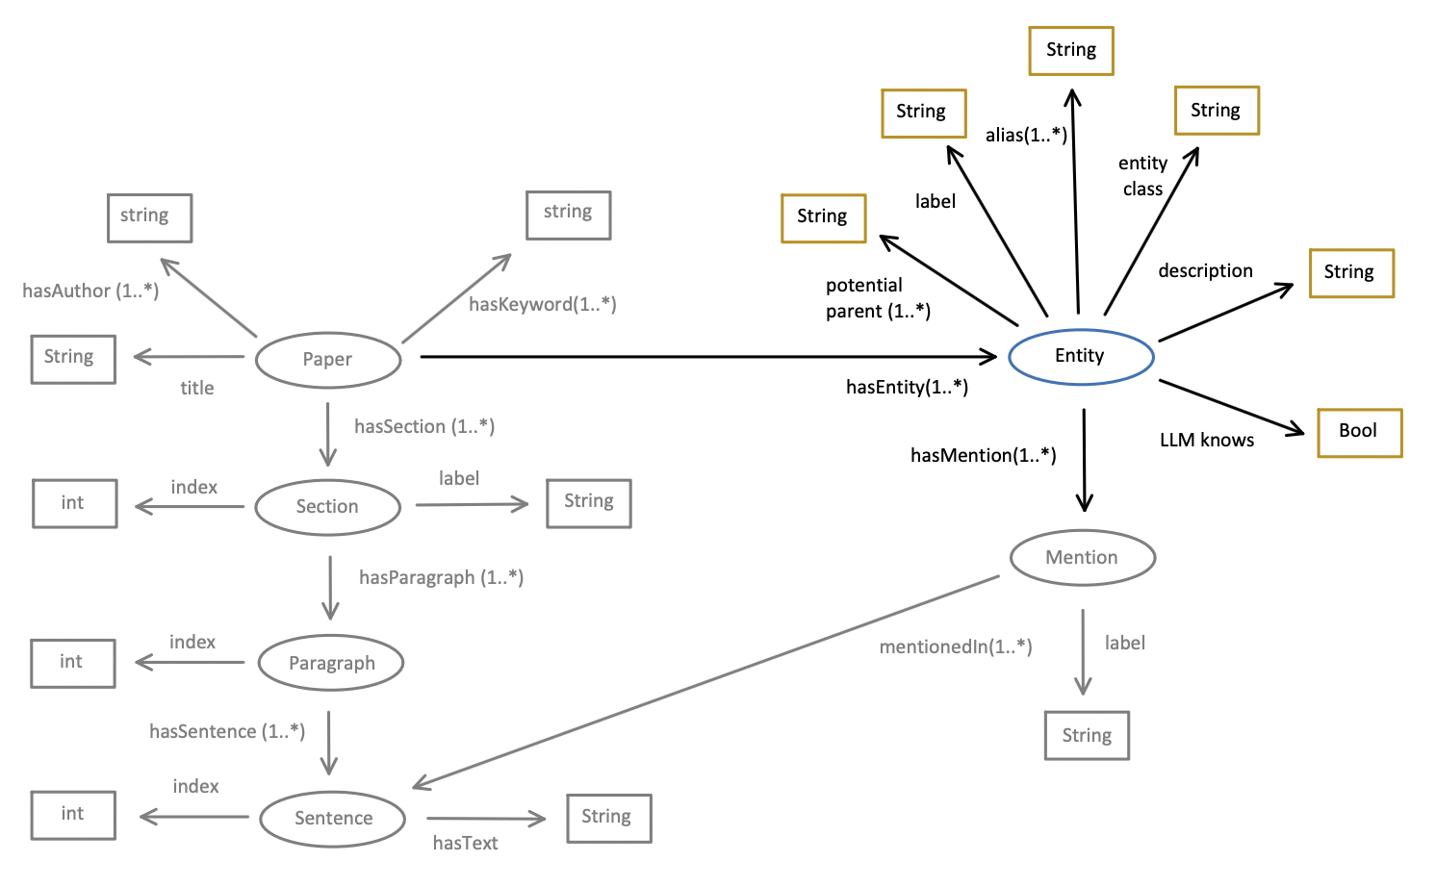
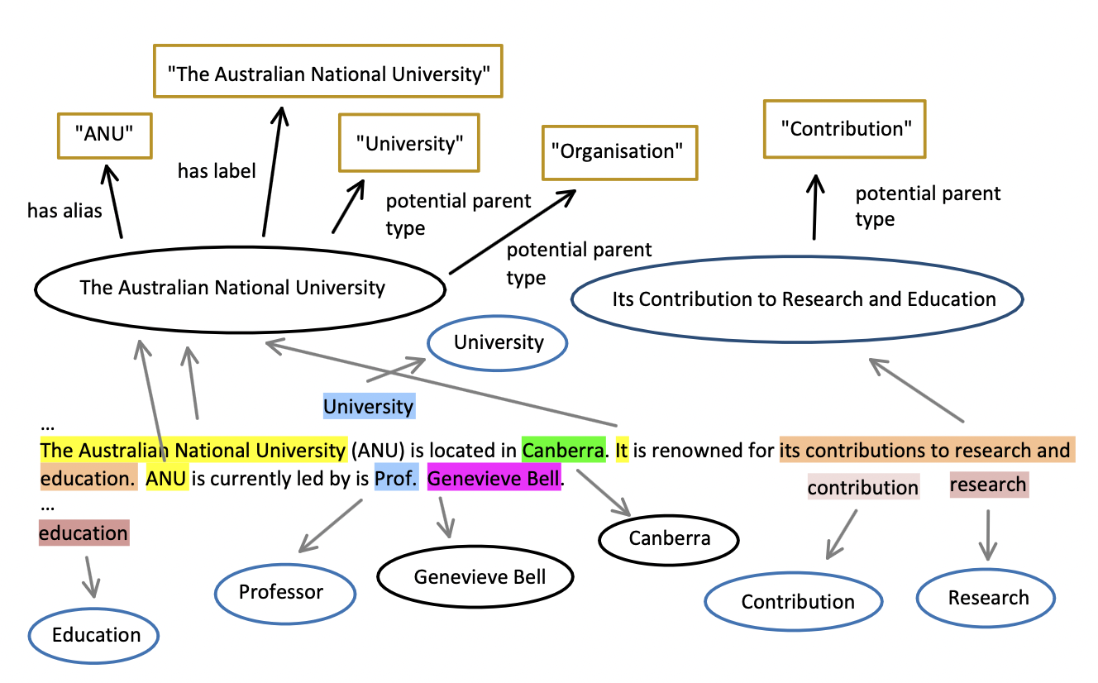
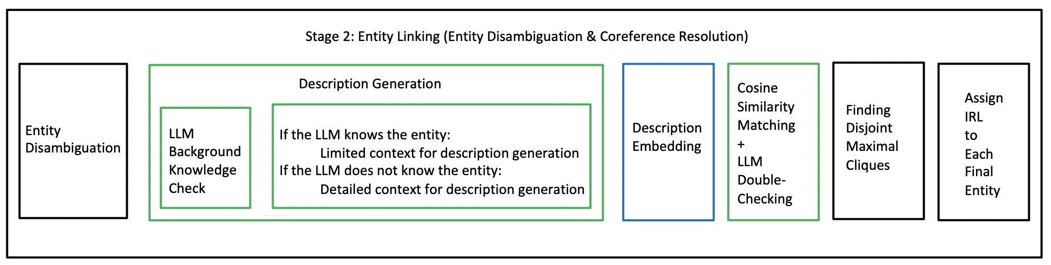
Stage 2: Entity Linking (Entity Disambiguation & Coreference Resolution
Key Idea:
1️⃣ Describe
2️⃣ Embed
3️⃣ Compare

Slide 11
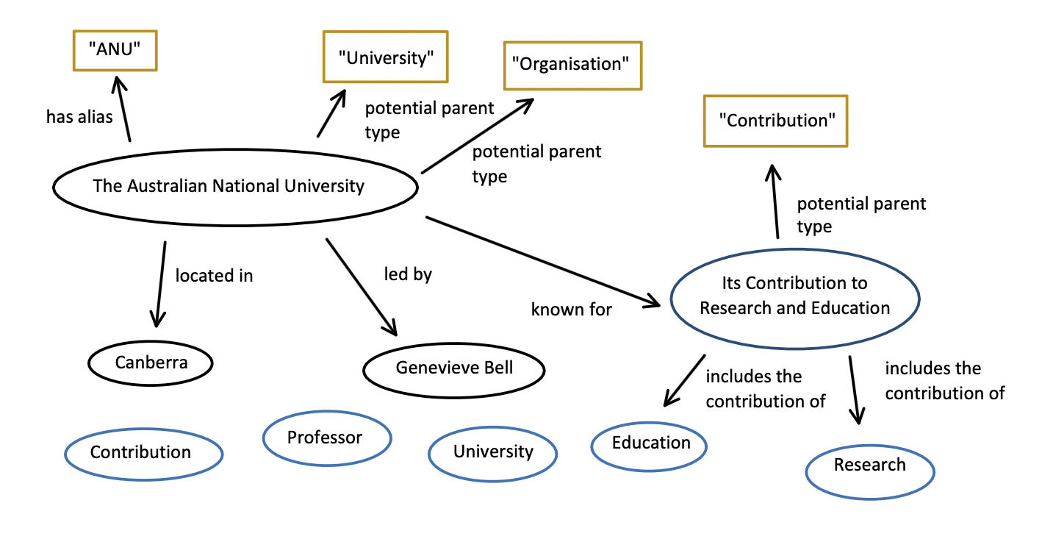
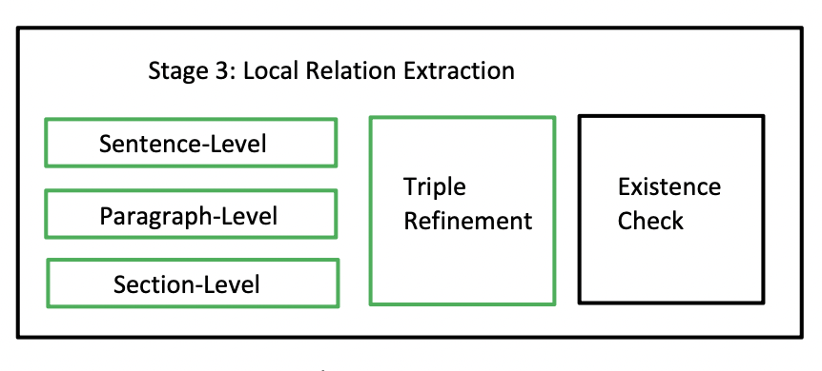
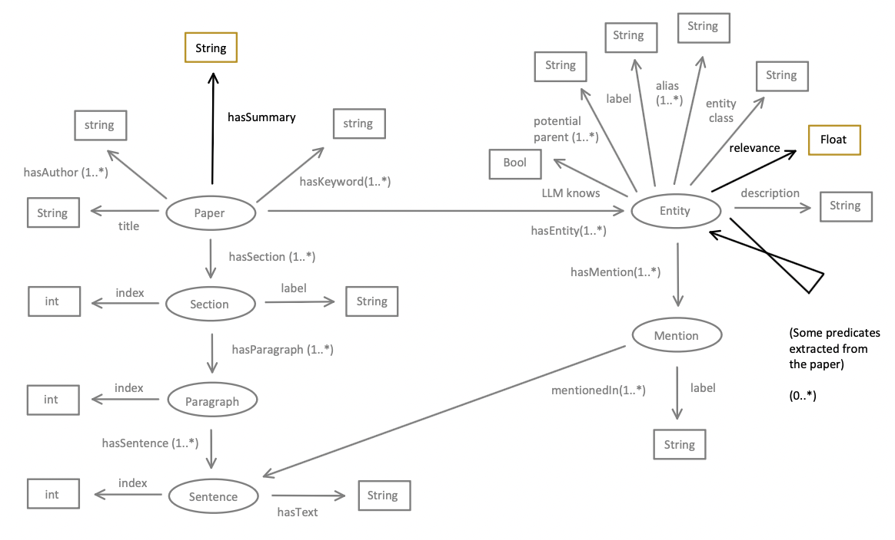
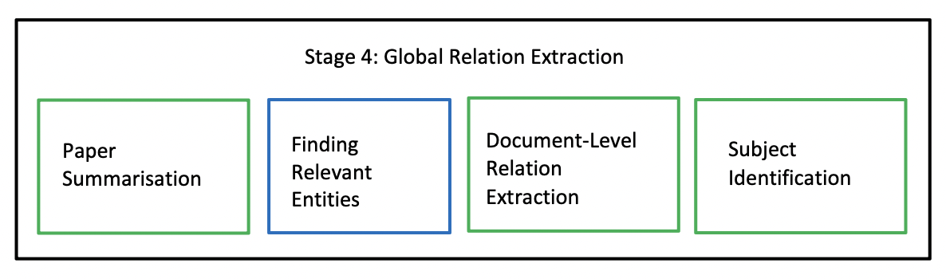
Stage 3: Local Relation Extraction
Stage 4: Global Relation Extraction

Slide 12
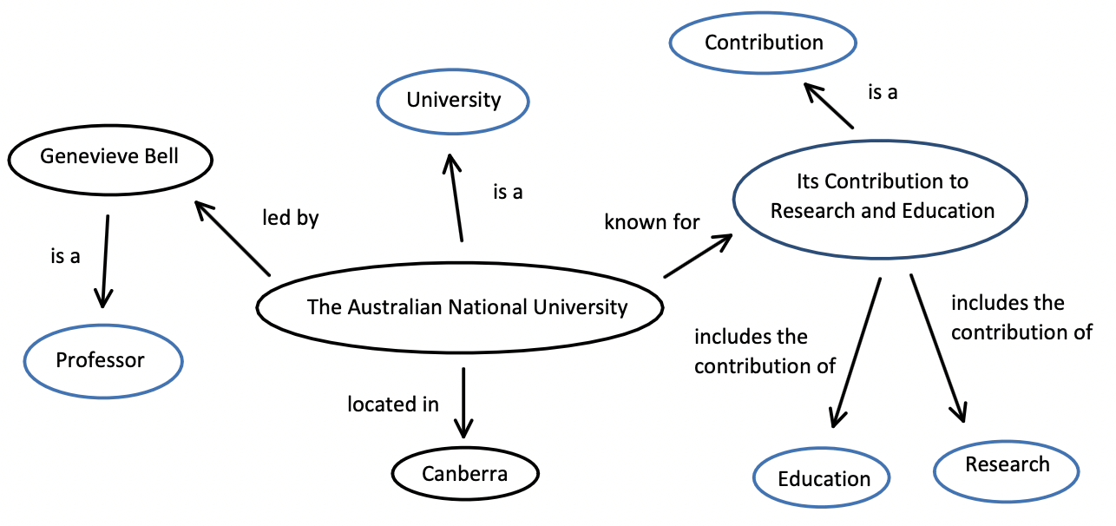
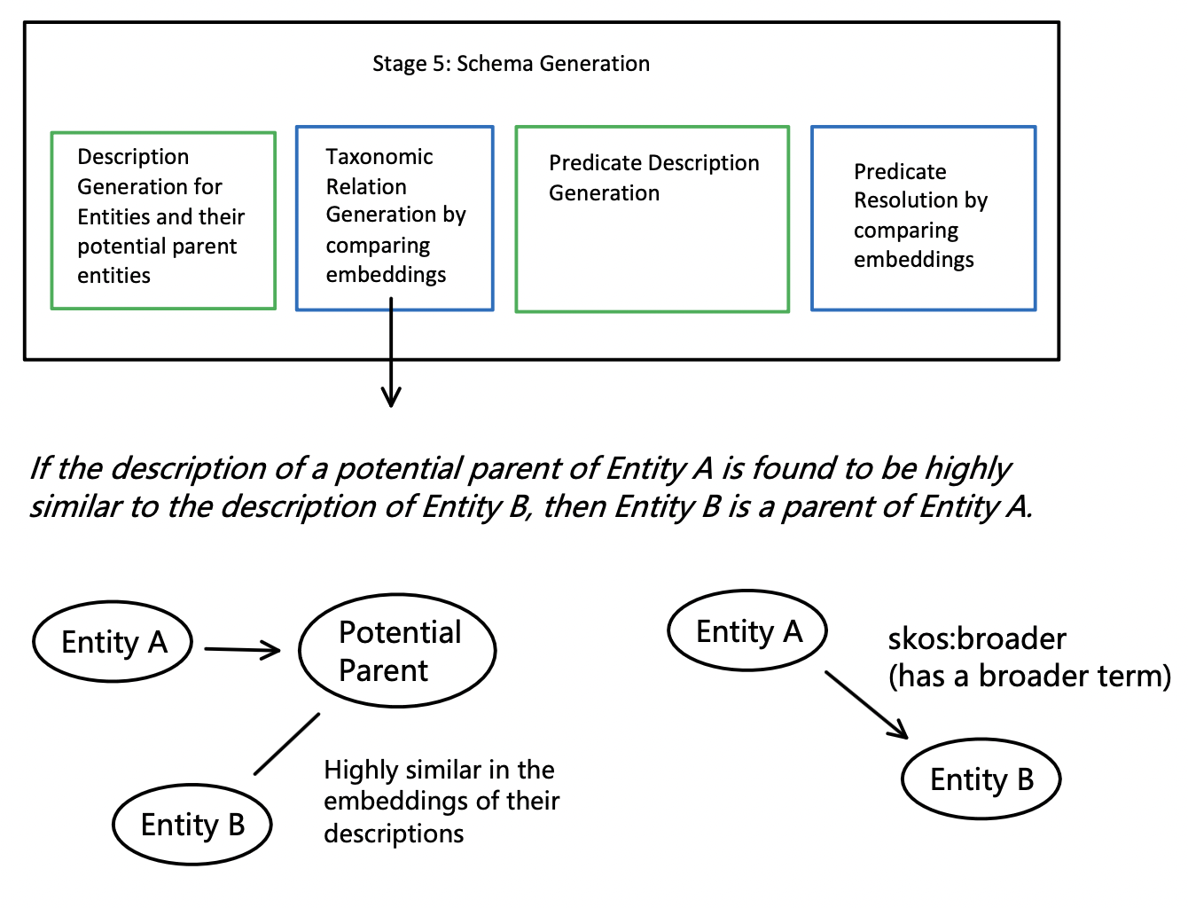
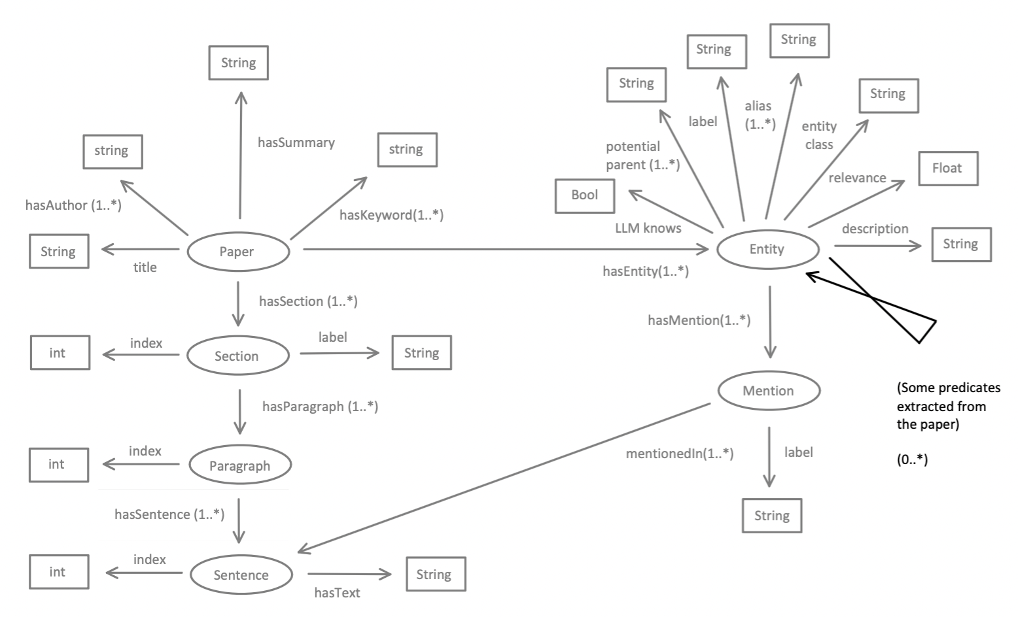
Key Idea: 1️⃣ Describe 2️⃣ Embed 3️⃣ Compare
Stage 5: Taxonomy Generation & Predicate Resolution

Slide 13
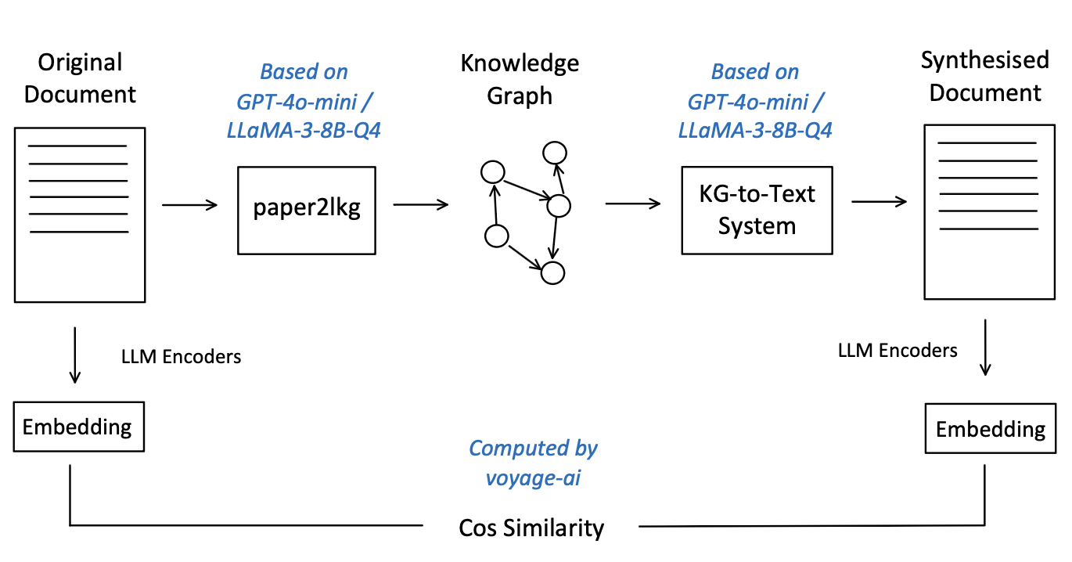
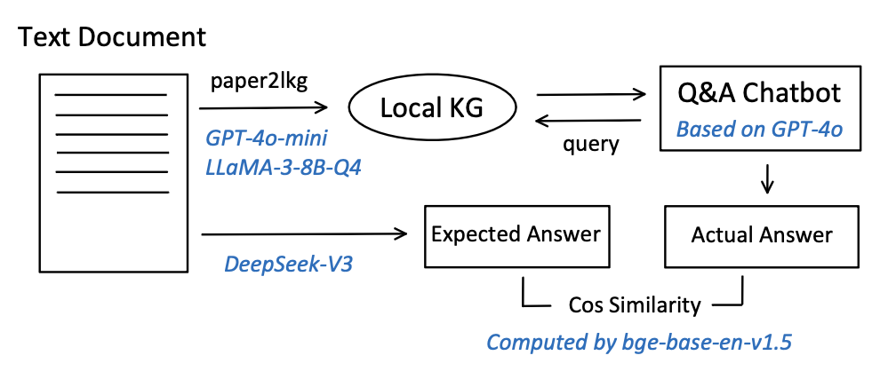
Evaluation Approaches
Limitations:
The embedding itself is lossy.
Must evaluate the whole system (paper2lkg + kg-to-test) together
Evaluation via Application
Idea: How effectively does a constructed local knowledge graph support answering questions related to the original document?
Evaluation via Reverse Engineering
Idea: How much information can a local knowledge graph preserve?
Dataset: 10 full papers from the ANU academic scholarly knowledge graph
100 abstract-only paper from SciERC (Entities, Relations, and Coreference for Scientific Knowledge Graph Construction)

Slide 14
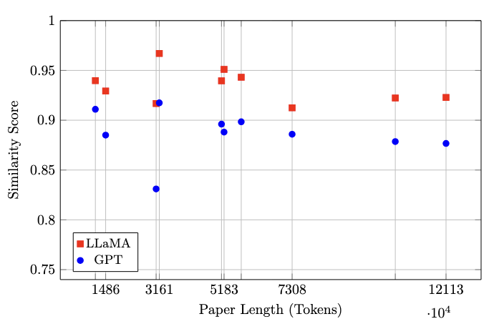
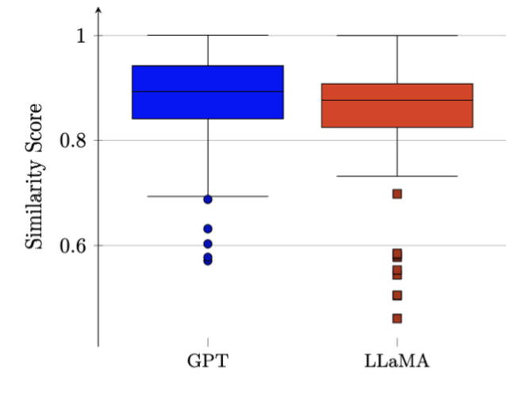
Evaluation (Output KG Quality)
Limitations:
The embedding itself is lossy.
Must evaluate the whole system (paper2lkg + kg-to-test) together
Evaluation via Reverse Engineering
Evaluation via Application
 | Mean | STD
LLaMA3-8B-Q3 | 0.93 | 0.016
GPT-4o-mini | 0.89 | 0.022
 | Mean | STD
LLaMA3-8B-Q3 | 0.85 | 0.113
GPT-4o-mini | 0.88 | 0.089

Slide 15
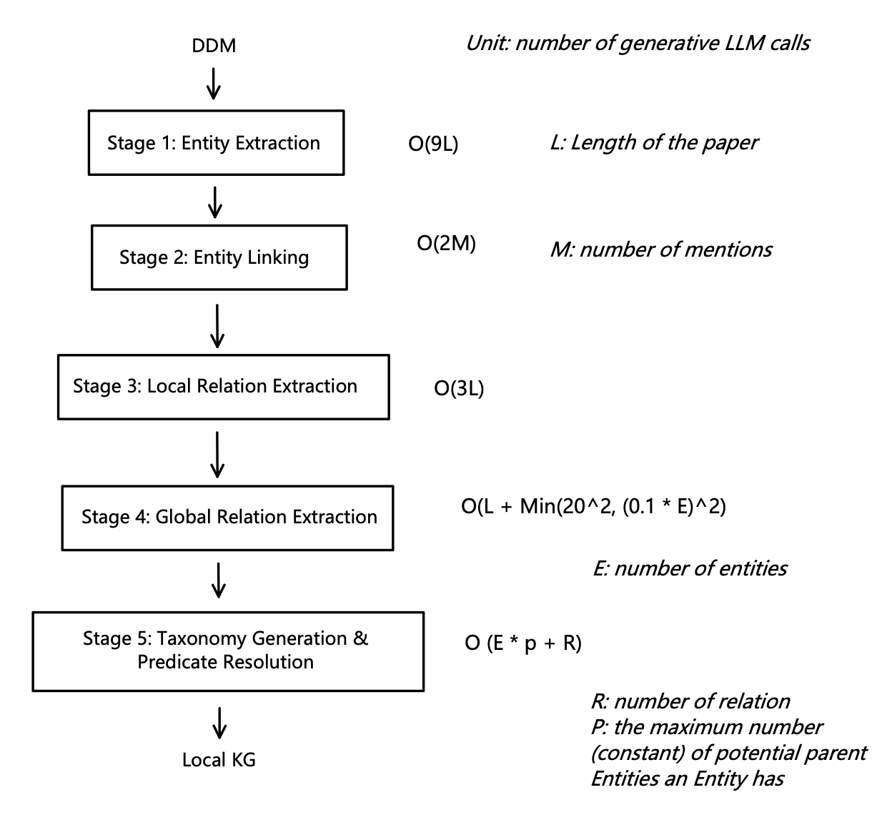
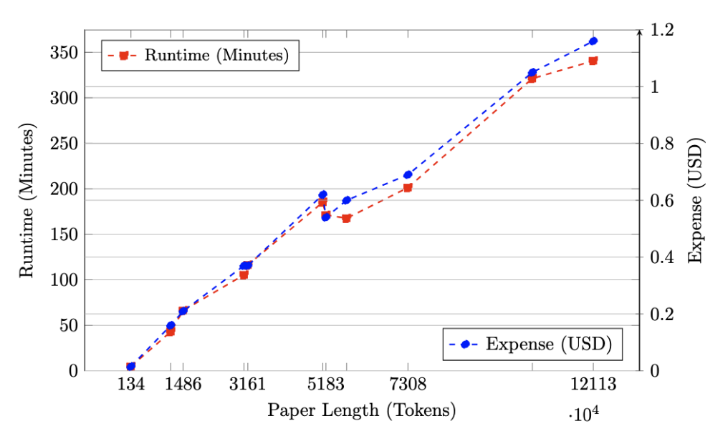
Evaluation (Complexity)

Slide 16
Conclusion
What did we do?
Has presented the paper2lkg pipeline, although it is still experimental and requires further improvement.
Found that such a pipeline may be slow, even though the complexity measure is linear, since every single generative LLM is expensive.
What might future research do?
A better LLM-based local academic KGC pipeline with higher output KG quality and lower complexity.
Integrating local academic KG into global academic KG.

Slide 17
Questions
Paper:
https://doi.org/10.1145/3701716.3717820
Artifact:
https://github.com/KGCP/paper2lkg

